Slide 1
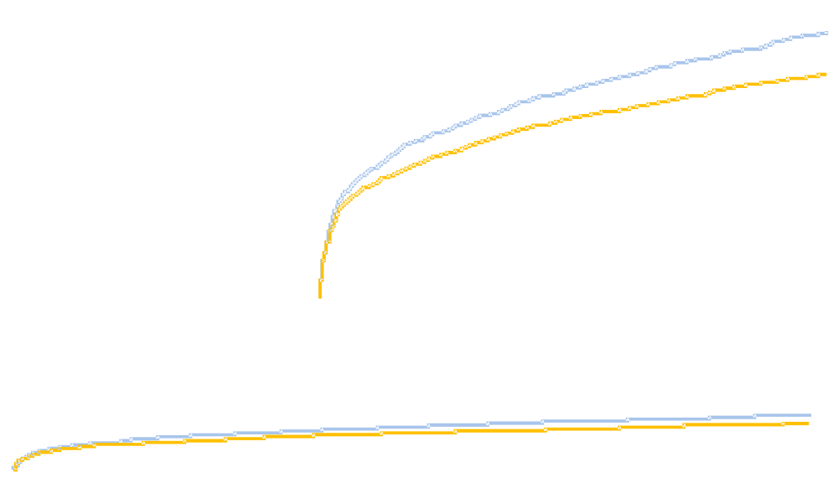
Ticagrelor significantly reduced the rate of MACE in ACS patients
100
12
Clopidogrel
11.7%
90
10
9.8%
80
8
70
Ticagrelor
6
60
Cumulative incidence
of primary endpoint (%)
4
p=0.0003
HR 0.84 (95% CI 0.77–0.92)
RRR = 16%, ARR = 1.87%, NNT = 54
50
2
40
0
30
0 2 4 6 8 10 12
20
10
p<0.001
0
0 2 4 6 8 10 12
MI HR 0.84 (0.75-0.95), p=0.005
Months
No. at risk
Ticagrelor 9333 8628 8460 8219 6743 5161 4147
Clopidogrel 9291 8521 8362 8124 6650 5096 4047
Prob/def stent thrombosis HR 0.75 (0.59-0.95), p=0.02
Death HR 0.78 (0.69-0.89), p<0.001
Wallentin L, et al. NEJM 2009;361:1045-57

